Slide 1







AGRICULTURE
HELP LOCAL FARMERS IN CROP PRODUCTION
Chang Jia Qian ANQSCL

Slide 2

OUTLINE
Business Use Case
Target Stakeholder
Business values
Data Overview
Data pipeline
KPI
Price Estimation
Business suggestions

Slide 3

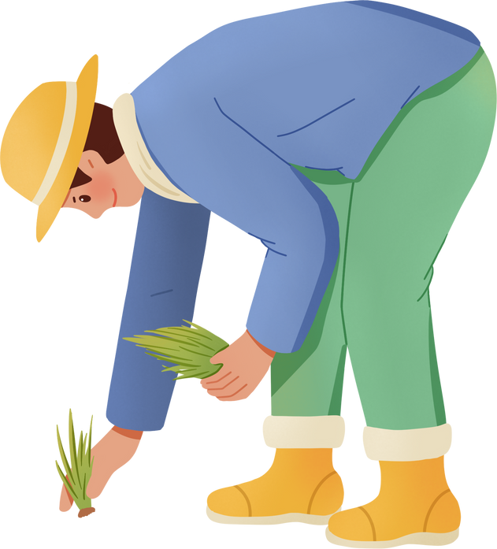
Farmers work hard to feed the world
BUSINESS CASE
If production is higher, more less people would starve
Monitor crop performance based on weather, soil type, irrigation, and other farm data
Provide insights for farm management decisionsl

Slide 4
Farmer
TARGET
STAKEHOLDER
Policy maker
Agriculture Businss Analyst
Researchers studying climate impact on crops

Slide 5
BUSINESS
VALUE
Understand weather impact on crop yield
Support data-driven irrigation and crop selection
Enable early warning insights for extreme weather conditions

Slide 6


DATA OVERVIEW
Agriculture dataset | Karnataka
Waether API: Open-Meteo
Location: India, Karnataka
Corps yield data
Includes crop types, land area, yield, soil type and many more
Minimum and maximum temperature data
Sunshine duration
Water evaporation (mm)

Slide 7

DATA PIPELINE
Data Catalog update
Weekly trigger
Folders created to store CSV, weather and solar data
AWS Glue Crawler
Eventbridge
Csv Data
S3 bucket
Stores Date
AWS Glue ETL Job
Data cleaning
Weather API
AWS Lambda
AWS Ethena
S3 bucket
Retrieve data
from api
Analyse and form insight
Store processed data

Slide 8
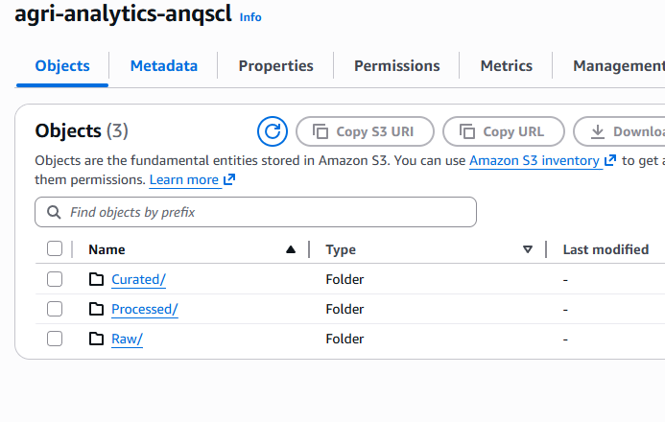
S3 BUCKET
I aslo created 2 folders within the S3 bucket to store raw and processed data. Curated folder was not used in the end but it was created initially

Slide 9
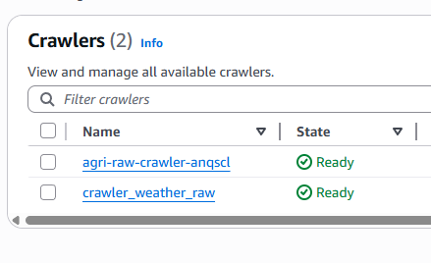
CRAWLER
Extract data from S3 bucket and save it was a table. Helpful when query data with Athena later

Slide 10
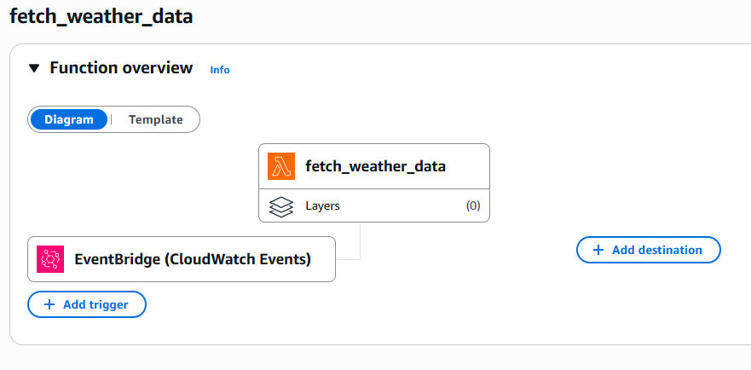
LAMBDA
Lambda is used to extract data from API and EventBridge act as a trigger to update weekly data

Slide 11
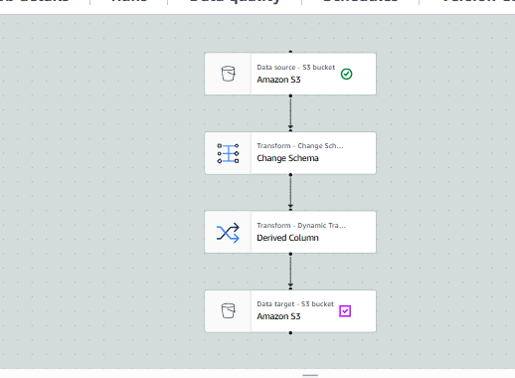
ETL JOB
I used ETL job to transform the schema of the data and derive new column

Slide 12
Understand weather impact on crop yield
KPI
Find out which irrigation method is more efficient
Support data-driven irrigation and crop selection
Average yield on crops
Best soil type per crop

Slide 13
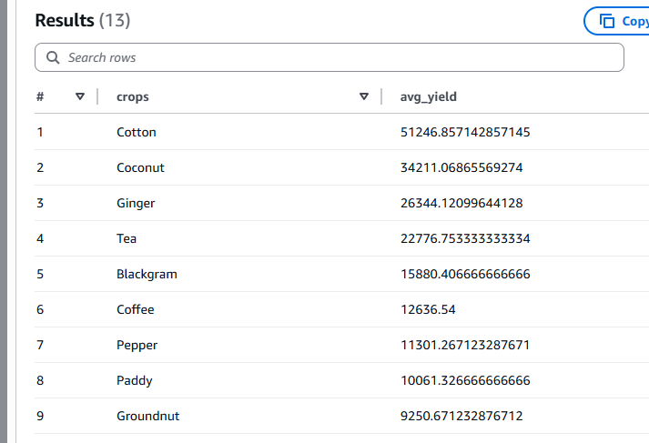
AVERAGE YIELD ON CROPS
Average yield here is the amount produced per unit per land area. However, the metadata do not provide abou the unit measure for the yield and also land aread

Slide 14
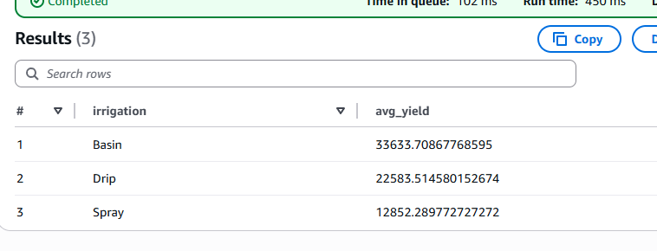
FIND OUT WHICH IRRIGATION METHOD IS MORE EFFICIENT
Basin is the best irrigation method, followed by drip and spray

Slide 15
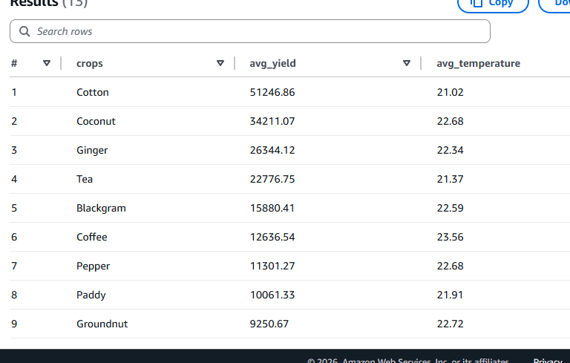
TEMPERATURE IMPACT ON CROP

Slide 16
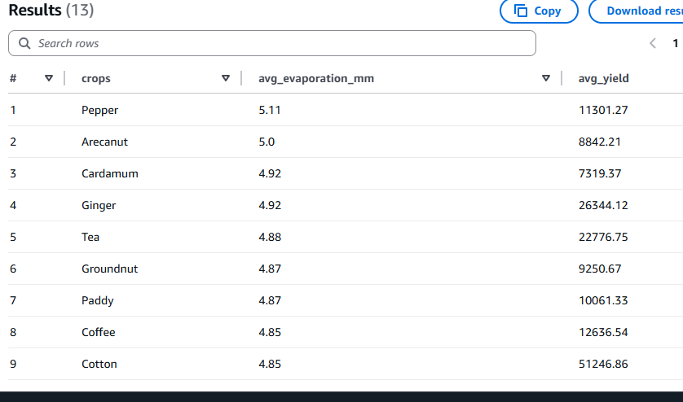
EVAPORATION IMPACT ON CROP YIELD

Slide 17
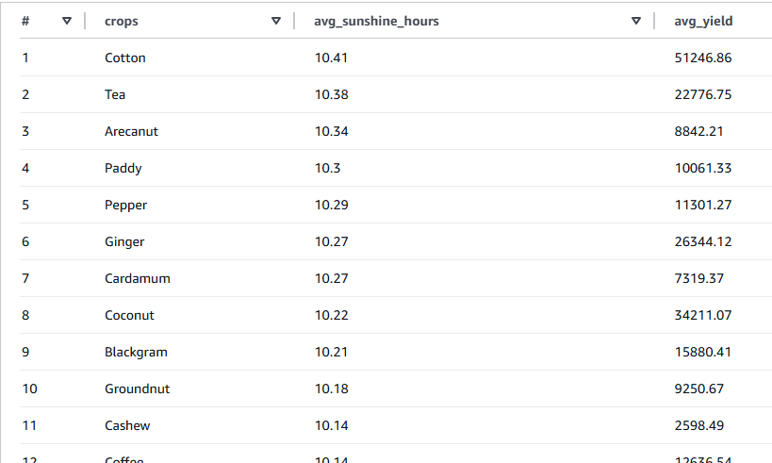
SUNSHINE IMPACT ON CROP YIELD

Slide 18
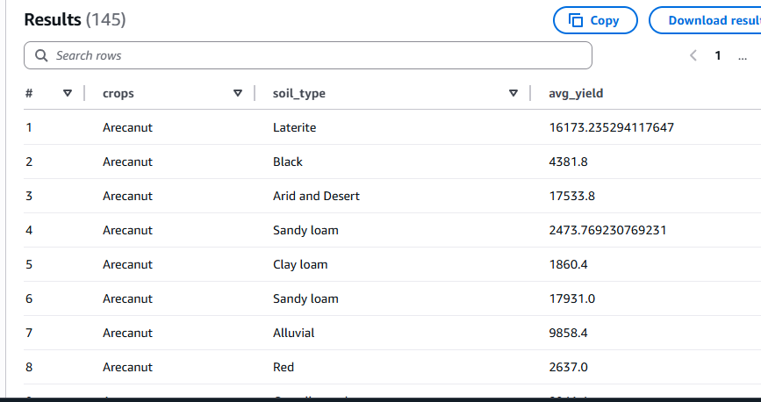
BEST SOIL TYPE PER CROP
To have the highest yield to grow Areca nut, use Laterite
soil.

Slide 19



COST
S3 | Yearly around 0.05 GB of data. | $0.001
Lambda | Triggered weekly. Runtime 5-10s | $0.00
Glue ETL Job + Crawler | 1 ETL Job and 2 crawlers (1 runs weekly) | $0.37
Athena | Maximum 20 queries scaned with less than 100 MB scan per query | $0.02
EventBridge | Only use once weekly | $0.00
Total:
$4.8

Slide 20
SUGGESTIONS
Use shade nets to grow crops if the temperature continues to increase each year due to global warming
If temperature increases, farmers would need to provide batter irrigation to provide more water for the crops
if farmers wants to use greenhouse to grow crops, they would need to buy sufficient LED lights.

Slide 21




THANK YOU

